Slide 1
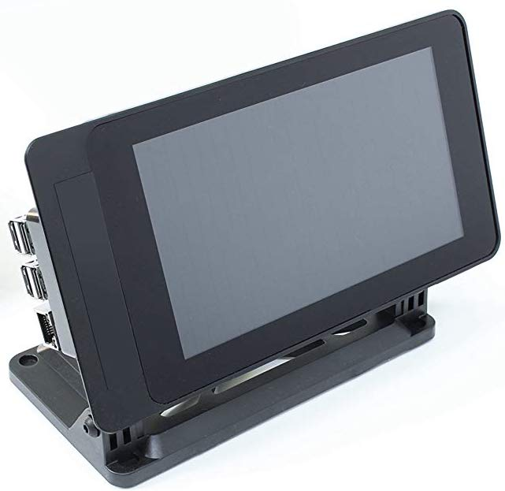
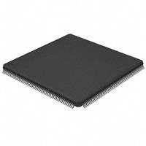
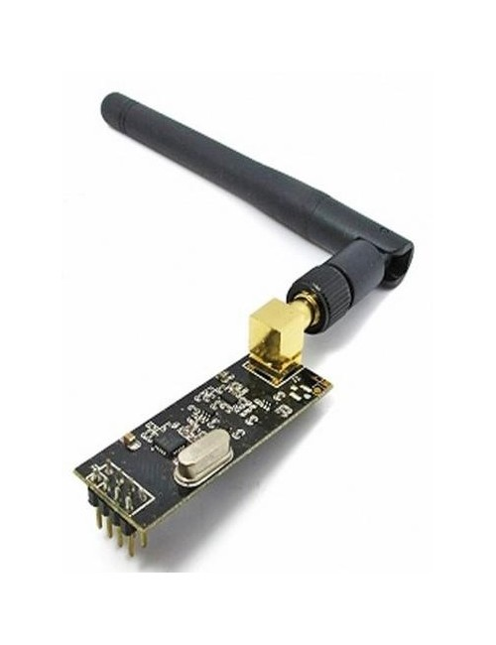


Cloud Control
Andrew Thompson | Reed Taylor| Brent Morada | Anna Lee
Background
PCB Design
Key Result #1 (e.g., thermal test, drop test, etc)
Communicating with groups of people during an emergency situation is an extremely important and challenging task. The Cloud Control project aims to relay messages from a ground control system to a target audience under a drone without being physically present.
Ground Control System:
User interface running on Raspberry Pi touch screen with a micrphone
f
Drone Module:
PCB with speaker system mounted on hexacopter drone
Insert picture of
PCB
Insert figure
Overview / Design Specs
Caption and/or text (preferably bullet points)
Describe key result (consider bullet point list).
Insert brief description of product, problems that it solves, bullet points of key features, etc
Critical Hardware Components
Key Result #2 / References / Conclusion
Raspberry Pi Ground Control System
Describe key component #1, including applicable specs
Insert figure
Exploded View / Block Diagram / Functional Flow Diagram
Insert Exploded View /
Block Diagram /
Functional Flow Diagram
LPC4088 Microcontroller
Describe key component #2, including applicable specs
NRF24 Wireless Module
Describe key component #4, including applicable specs
Describe key result (consider bullet point list).
Acknowledgements:
Special thanks to Phil Tokumaru, Yogananda Isukapalli, Brandon Pon, and Carrie Segal.

